Slide 1
You Only Look Once (YOLO)
Notes:
1

Slide 2

Object Detection
Image Courtesy: Wikipedia.org

Slide 3
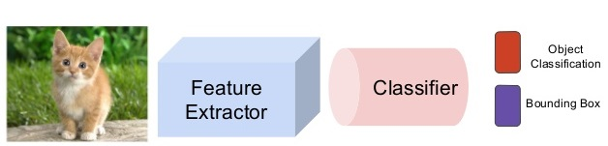
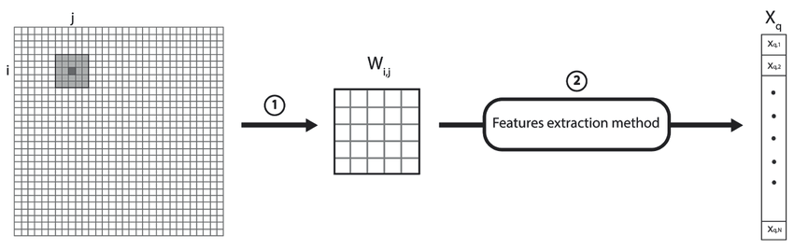
Classification Pipeline
Image Courtesy: slideshare.net,
Researchgate.net

Slide 4
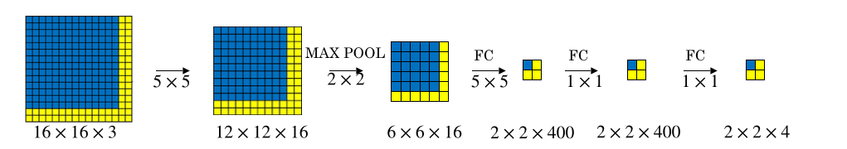
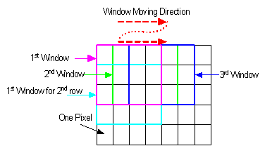
Sliding Window
Image Courtesy: Andrew Ng, sites.google.com

Slide 5
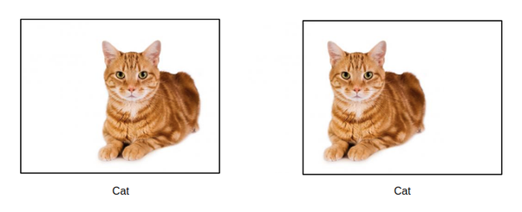
Shift Invariance
Image Courtesy: quora.com

Slide 6
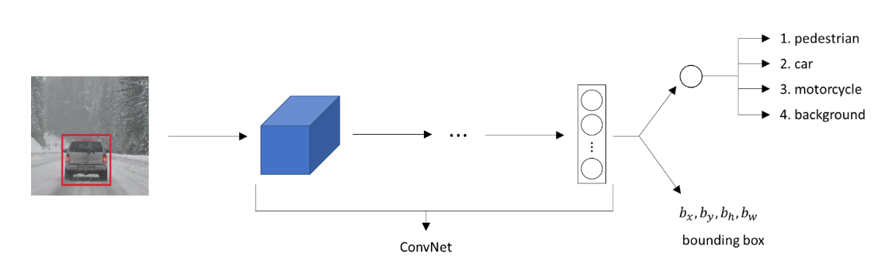
Scale and Rotation
Image Courtesy: datahacker.rs

Slide 7
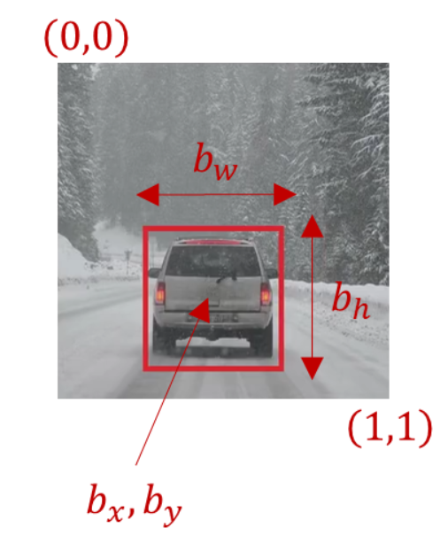
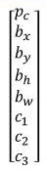
Training Data
Image Courtesy: datahacker.rs

Slide 8
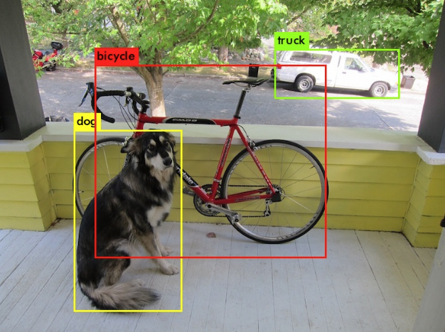
Multiple Objects?
Image Courtesy: towardsdatascience.com

Slide 9
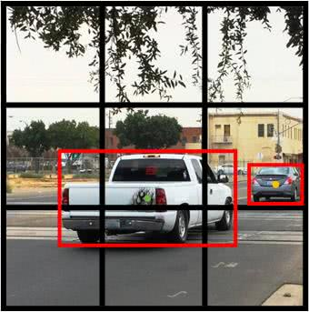
YOLO Idea
Image Courtesy: dlology.com

Slide 10
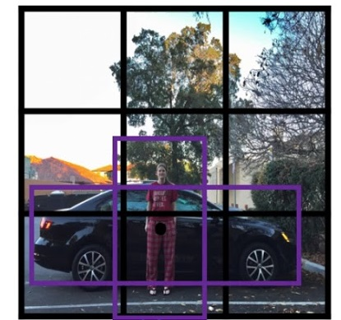
YOLO Anchor Boxes
Image Courtesy: Andrew Ng

Slide 11
YOLO Summary
Image Courtesy: Andrew Ng

Slide 12
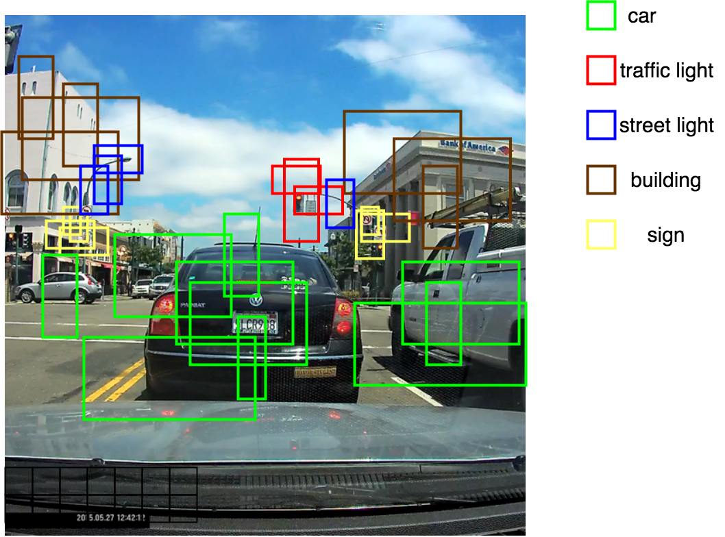
Non Maxima Suppression
Image Courtesy: medium.com

